Slide 1
Discrete Structures
5. Proofs
Objectives
to introduce proofs: assumptions, conclusions, rules of inference; different ways of proving if-then statements

Slide 2
Overview
1. What is a Proof?
2. Rules of Inference
3. Using Rules to Build a Proof
4. More Inference Rules
5. Examples

Slide 3
1. What is a Proof?
Two assumptions /premises / statements:
“All men are mortal.”
and
“Socrates is a man.”
Prove the conclusion:
“Socrates is mortal.”
the steps in going from
assumptions to a conclusion
is called a proof
proof
assumptions
conclusion

Slide 4
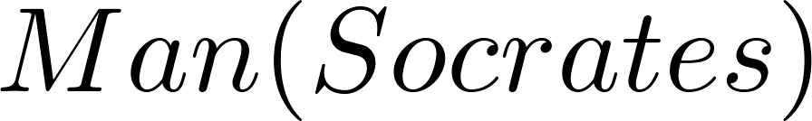
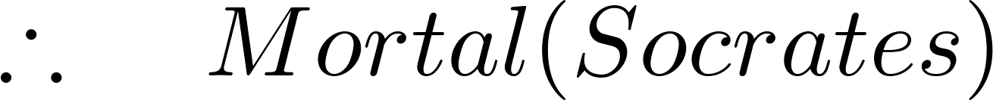
In Logic
Pred. Sec 4.1
assumptions
how do
we prove
this?
conclusion
Rules of inference are used to create a proof
most rules work with both propositional and predicate logic

Slide 5
2. Rules of Inference
For proofs using propositional logic:
Modus Ponens
Modus Tollens
Hypothetical Syllogism
Disjunctive Syllogism
Addition
Simplification
Conjunction
Resolution
rules involving →
(used a lot)
used in the Prolog
logic programming
language

Slide 6
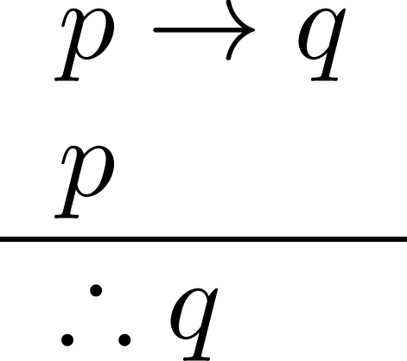
2.1. Modus Ponens
assumptions
conclusion
Example
Let p be “It is snowing.”
Let q be “I study discrete math.”
p → q: “If it is snowing, then I study discrete math.”
p: “It is snowing.”
q: “I study discrete math.”
Notes:
p -> q: "If it is raining, then there are clouds in the sky." p: "It is raining." ---------- q: "There are clouds in the sky.“
W -> C: If Yankees win today's game, they will be champions. W: Yankees win today's game. ---------- C: Yankees are champions.
W -> B: If the weather is good, we can go to the beach. W: The weather is good. ---------- B: We can go to the beach.

Slide 7
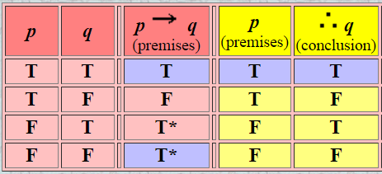
Modus ponens

Slide 8
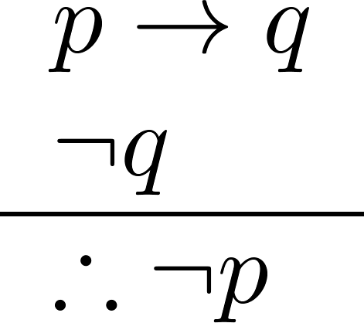
2.2. Modus Tollens
Example
Let p be “it is snowing.”
Let q be “I study discrete math.”
p → q: “If it is snowing, then I study discrete math.”
¬q: “I do not study discrete math.”
¬p: “It is not snowing.”

Slide 9
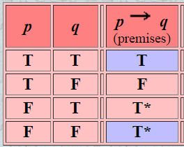
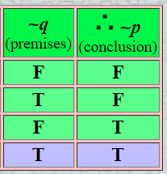
Modus tollens

Slide 10
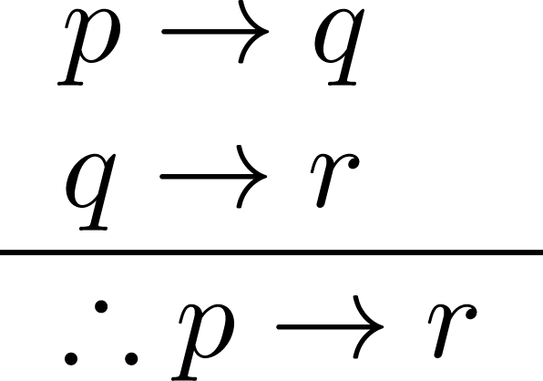
2.3. Hypothetical syllogism’
This may be why math
people use the → symbol
assumptions
p
q
r
Example
Let p be “it snows.”
Let q be “I study discrete math.”
Let r be “I will get an A.”
p → q: “If it snows, then I study discrete math.”
q → r: “If I study discrete math, then I will get an A.”
p → r: “If it snows, then I will get an A.”
conclusion
Notes:
Also known as hypotheical sylogism

Slide 11
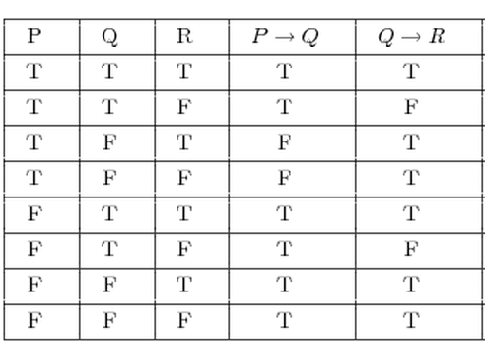
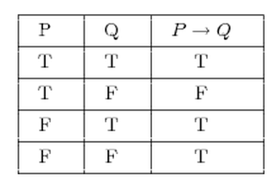
T
p → q
This shows why using truth tables for proofs does not scale up.
T
q → r
possible
values
for p, r
R
R
?
p → r

Slide 12
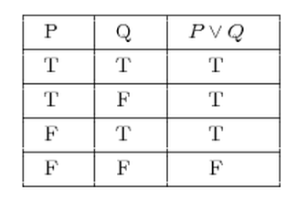
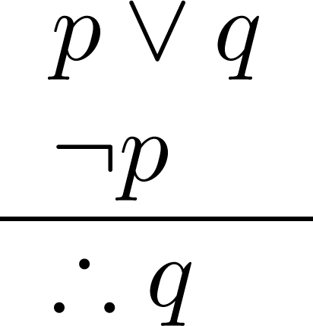
2.4. Disjunctive Syllogism
p ∨ q
T
¬p
T
??
the “get part of ∨“ rule
q
Example
Let p be “I study discrete math.”
Let q be “I study English literature.”
p ∨ q: “I study discrete math or I study English literature.”
¬p: “I do not study discrete math.”
q: “I study English literature.”

Slide 13
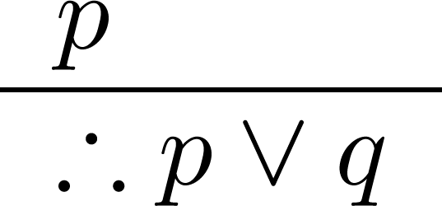
2.5. Addition
p
T
the “add anything ∨“ rule
??
p ∨ q
Example
Let p be “I study discrete math.”
Let q be “I will visit the Moon.”
p: “I study discrete math.”
p ∨ q: “I study discrete math or I will visit the Moon.”

Slide 14
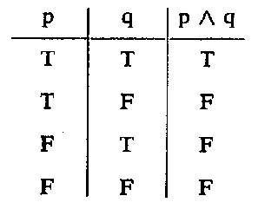
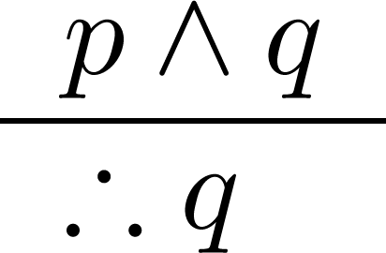
2.6. Simplification
?
T
q
p ∧ q
p
?
Two rules
the “get part of ∧“ rule
p
Example
Let p be “I study discrete math.”
Let q be “I study English literature.”
p ∧ q: “I study discrete math and English literature”
q: “I study discrete math.”

Slide 15
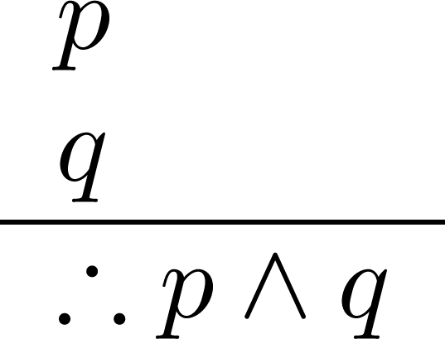
2.7. Conjunction
T
p
T
?
q
p ∧ q
the “combine two
statements with ∧“ rule -- useful
Example
Let p be “I study discrete math.”
Let q be “I study English literature.”
p: “I study discrete math.”
q: “I study English literature.”
p ∧ q: “I study discrete math and I study English literature.”

Slide 16
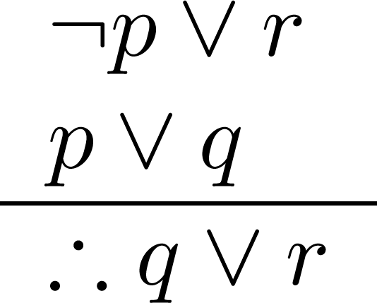
2.8. Resolution
Graphically:
¬p ∨ r
p ∨ q
q ∨ r
Example
Let p be “I study discrete math.”
Let r be “I study English.”
Let q be “I study databases.”
¬p ∨ r: “I do not study discrete math or I study English.”
p ∨ q: “I study discrete math or I study databases.”
q ∨ r: “I study databases or I study English.”

Slide 17
3. Using Rules to Build a Proof
Each statement (line) is either an assumption or a new statement made by using a rule of inference.
S₁
S₂
.
.
.
S_{n}
C
assumptions or
new statements
and
this sequence of statements is
the proof
conclusion

Slide 18
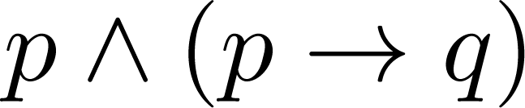
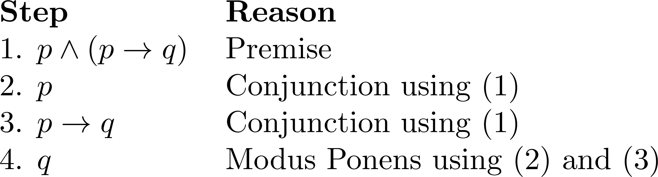
Example 1
Assumption:
Show that q is a conclusion.
Simplification
Simplification

Slide 19
Example
Four Assumptions:
“It is not sunny and it is colder than yesterday.”
“We will go swimming only if it is sunny.”
“If we do not go swimming, then we will take a canoe trip.”
“If we take a canoe trip, then we will be home by night.”
Show the conclusion:
“We will be home by night.”
a q if p
example
continued

Slide 20
Create propositional variables:
p: “It is sunny.” r: “We will go swimming.”
q: “It is colder than yesterday. s: “We will take a canoe trip.”
t: “We will be home by night.”
Translation problem into propositional logic:
Four assumptions:
¬p ∧ q r → p ¬r → s s → t
Conclusion:
t

Slide 21
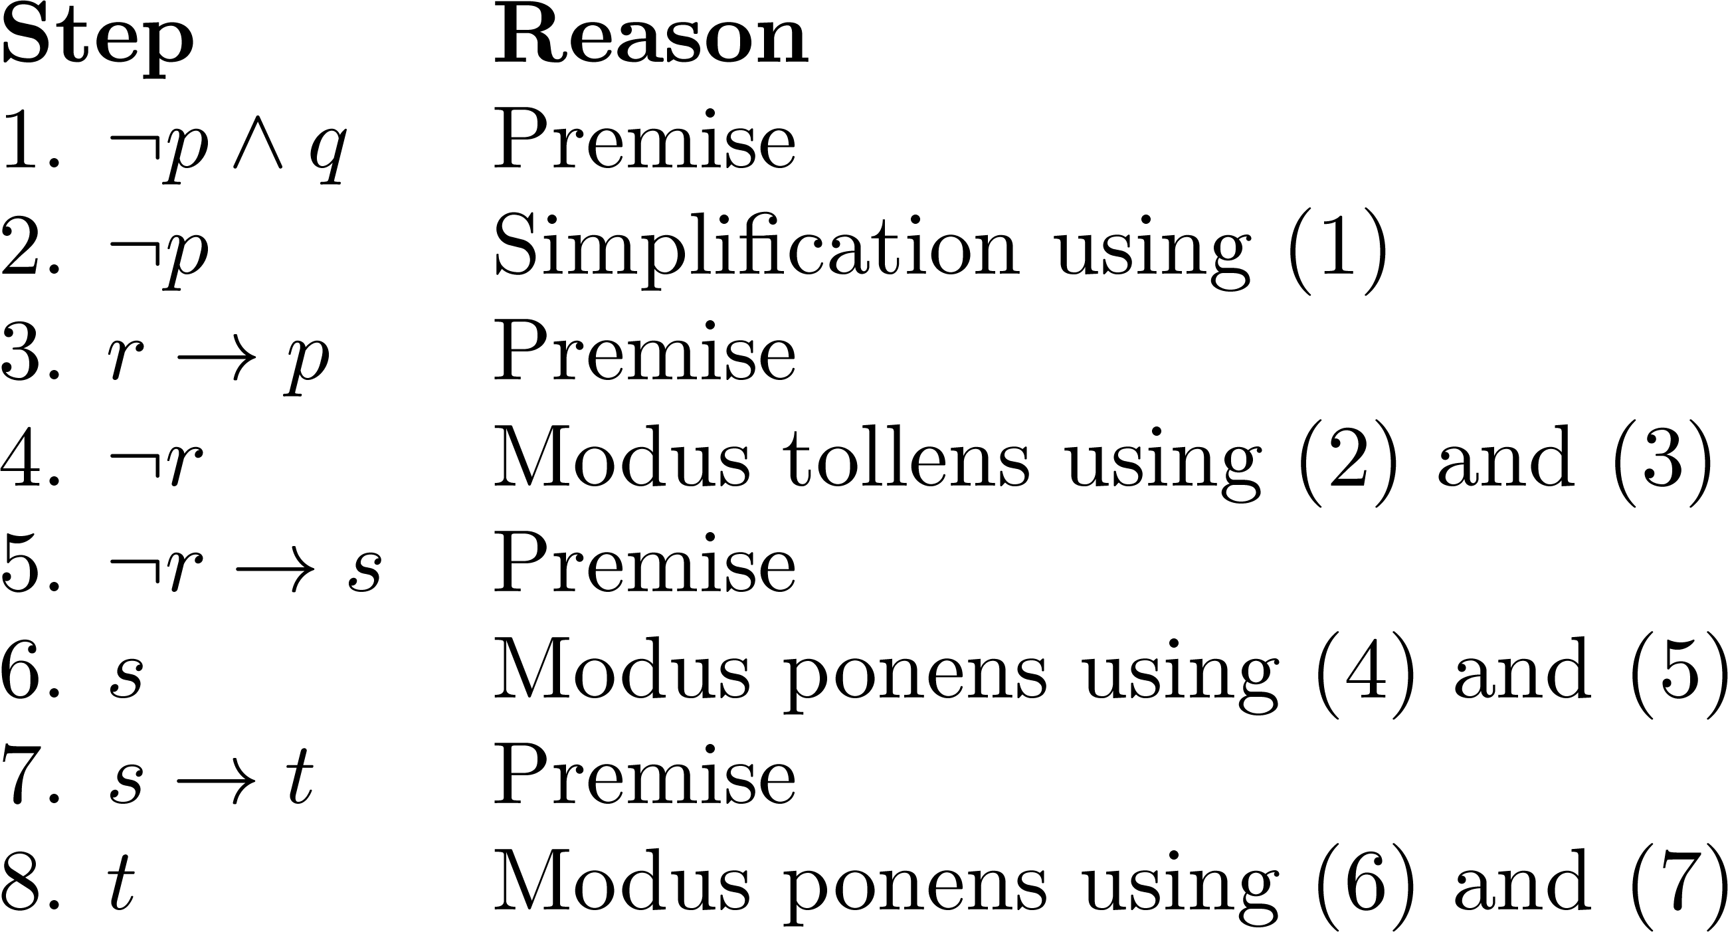
3. Construct the proof
Notes:
Note that a truth table would have 32 rows since we have 5 propositional variables.

Slide 22
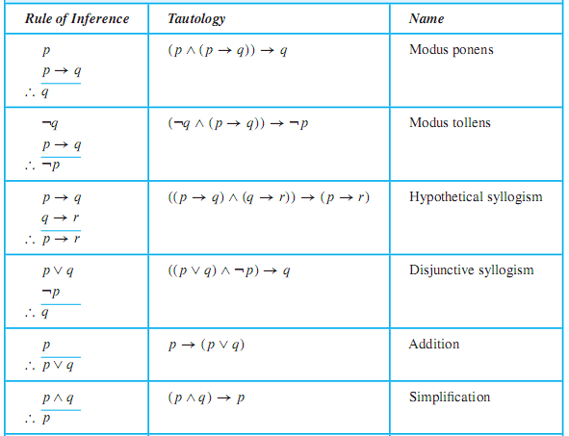
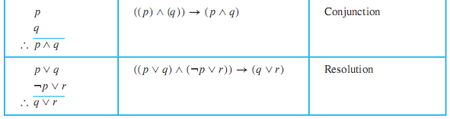

Slide 23
Example for rule of inference
Example: A Valid Argument
“You are a intelligent student.”
“If you are a intelligent student, then you can avail scholarship.”
Therefore, “You can avail scholarship.”

Slide 24
Arrive the conclusion:
p
p → q
s ∨ r
r → ¬q
Arrive at the conclusion:
s
Step Reason
1) p Premise
2) p → q Premise
3) q Modus Ponens (using 1, 2)
4) r → ¬q Premise
5) q → ¬r Contrapositive statement of 4
6) ¬r Modus Ponenes (using 3, 5)
7) s ∨ r Premise
8) s Disjunctive Syllogism (using 6, 7)

Slide 25
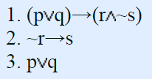
Use the rules of inference to affirm that the arguments below are valid.
1. (p q)→(r ~s)
2. ~r→s
3. p q
Prove R
Solution :
Modus ponens, simplification, Tollens

Slide 26

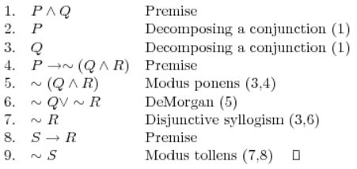
For premises
Prove: ~ S:
2

Slide 27

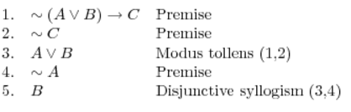
For premises
Prove: B

Slide 28
Example
: Show that the hypotheses “If you send me an email message, then I will finish writing the program,”
“If you do not send me an email message, then I will go to sleep early,”
and “If I go to sleep early, then I will wake up feeling refreshed”
lead to the conclusion “If I do not finish writing the program, then I will wake up feeling refreshed.”

Slide 29
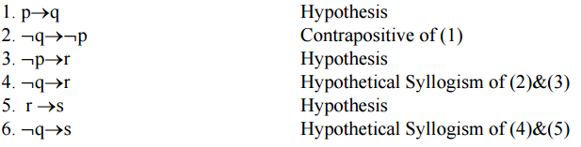
solution
p: “You send me an email message”
q: “I will finish writing the program”
r: “I will go to sleep early”
s: “I will wake up feeling refreshed.”
Then the hypotheses are p→q, ¬p→r, r →s and the conclusion is ¬q→s.

Slide 30
Example
Find the argument form for the following argument and determine whether it is valid. Can we conclude that the conclusion is true if the premises are true?
If Socrates is human, then Socrates is mortal.
Socrates is human.
∴ Socrates is mortal.
MODUS PONENS

Slide 31
Example
M -> C: If you get enough money, you can buy a new car. ~C: You cannot buy a new car. ---------- ~M: You didn't get enough money.
Modus tollens
S -> F: If there is smoke, there is a fire. ~F: There is no fire. ---------- ~S: There is no smoke.

Slide 32
Example
Show that the premises “Everyone in this discrete mathematics class has taken a course in computer science” and “Marla is a student in this class” imply the conclusion “Marla has taken a course in computer science.”
Let D(x) denote “x is in this discrete mathematics class,” Let C(x) denote “x has taken a course in computer science.”
Then the premises are ∀x(D(x) → C(x)) and D(Marla).
The conclusion is C(Marla).

Slide 33
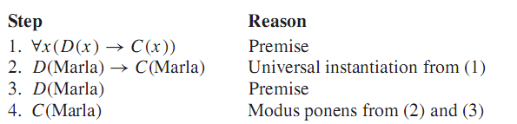
Solution:

Slide 34
Problem
“A student in this class has not read the book,”
“Everyone in this class passed the ﬁrst exam” imply the conclusion “Someone who passed the ﬁrst exam has not read the book.”
Solution:
Let C(x) be “x is in this class,”
B(x) be “x has read the book,”
P(x) be “x passed the ﬁrst exam.”
The premises are ∃x(C(x) ∧¬B(x)) and ∀x(C(x) → P(x)). The conclusion is ∃x(P(x) ∧¬B(x)).

Slide 35
What rule of inference is used in each of these arguments?
a) Alice is a mathematics major. Therefore, Alice is either a mathematics major or a computer science major.
b) Jerry is a mathematics major and a computer science major. Therefore, Jerry is a mathematics major.
c) If it is rainy, then the pool will be closed. It is rainy. Therefore, the pool is closed.
d) If it snows today, the university will close. The university is not closed today. Therefore, it did not snow today.
e) If I go swimming, then I will stay in the sun too long. If I stay in the sun too long, then Iwill sunburn. Therefore, if I go swimming, then I will sunburn.

Slide 36
9. For each of these collections of premises, what relevant conclusion or conclusions can be drawn? Explain the rules of inference used to obtain each conclusion from the premises.
a) “If I take the day off, it either rains or snows.” “I took Tuesday off or I took Thursday off.” “It was sunny on Tuesday.” “It did not snow on Thursday.”
b) “If I eat spicy foods, then I have strange dreams.” “I have strange dreams if there is thunder while I sleep.” “I did not have strange dreams.”
c) “I am either clever or lucky.” “I am not lucky.” “If I am lucky, then I will win the lottery.”
d) “Every computer science major has a personal computer.” “Ralph does not have a personal computer.” “Ann has a personal computer.”
e) “What is good for corporations is good for the United States.” “What is good for the United States is good for you.” “What is good for corporations is for you to buy lots of stuff.”
f) “All rodents gnaw their food.” “Mice are rodents.” “Rabbits do not gnaw their food.” “Bats are not rodents.”

Slide 37
13. For each of these arguments, explain which rules of inference are used for each step.
“Doug, a student in this class, knows how to writeprograms in JAVA. everyonewho knows howtowrite programs in JAVA can get a high-paying job. Therefore, someone in this class can get a high-paying job.
Bhavika will work in an enterprise this summer. Therefore, this summer Bhavika will work in an enterprise or he will go to beach. ”
b) “Somebody in this class enjoys whale watching. Every person who enjoys whale watching cares about
ocean pollution. Therefore, there is a person in this class who cares about ocean pollution.”
c) “If I go for a balanced diet, then I will be fit. If I will be fit, then I will remain healthy. Therefore, if I go for a balanced diet, then I will remain healthy.”
“Each of the 93 students in this class owns a personal computer. Everyone who owns a personal computer can use a word processing program. Therefore, Zeke, a student in this class, can use a word processing program.”
d) “Everyone in New Jersey lives within 50 miles of the ocean. Someone in New Jersey has never seen the ocean. Therefore, someone who lives within 50 miles
of the ocean has never seen the ocean.”

